Slide 1
Citi Bike Data Analysis
By Ellie Learmond

Slide 2
Project Goal:
To better understand the behavior of Citi Bike’s customer base (both one-time users and subscribers) and how they use Citi Bikes
This will help us to:
Identify where more bikes should be installed
Create targeted marketing campaigns that will appeal to different customer segments

Slide 3
Key questions:
What are the most popular pick-up locations across the city for Citi Bike rental?
How does the average trip duration vary across different age groups?
Which age group rents the most bikes?
How does bike rental vary across the two user groups (one-time users vs long-term subscribers) on different days of the week?
Does the factor of user age impact the average bike trip duration?

Slide 4
Findings & Insights

Slide 5
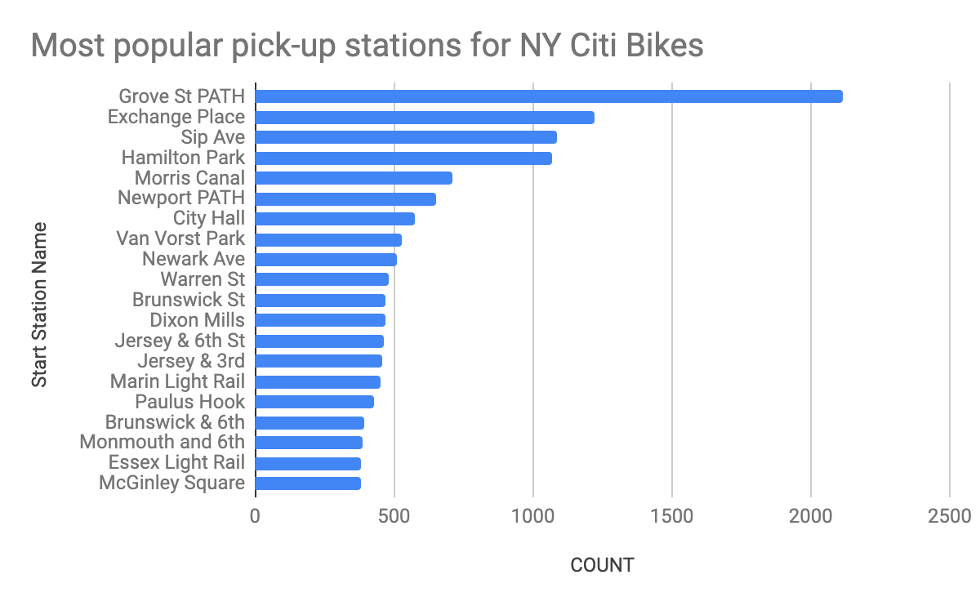
What are the most popular Citi Bike pick-up locations?

Slide 6
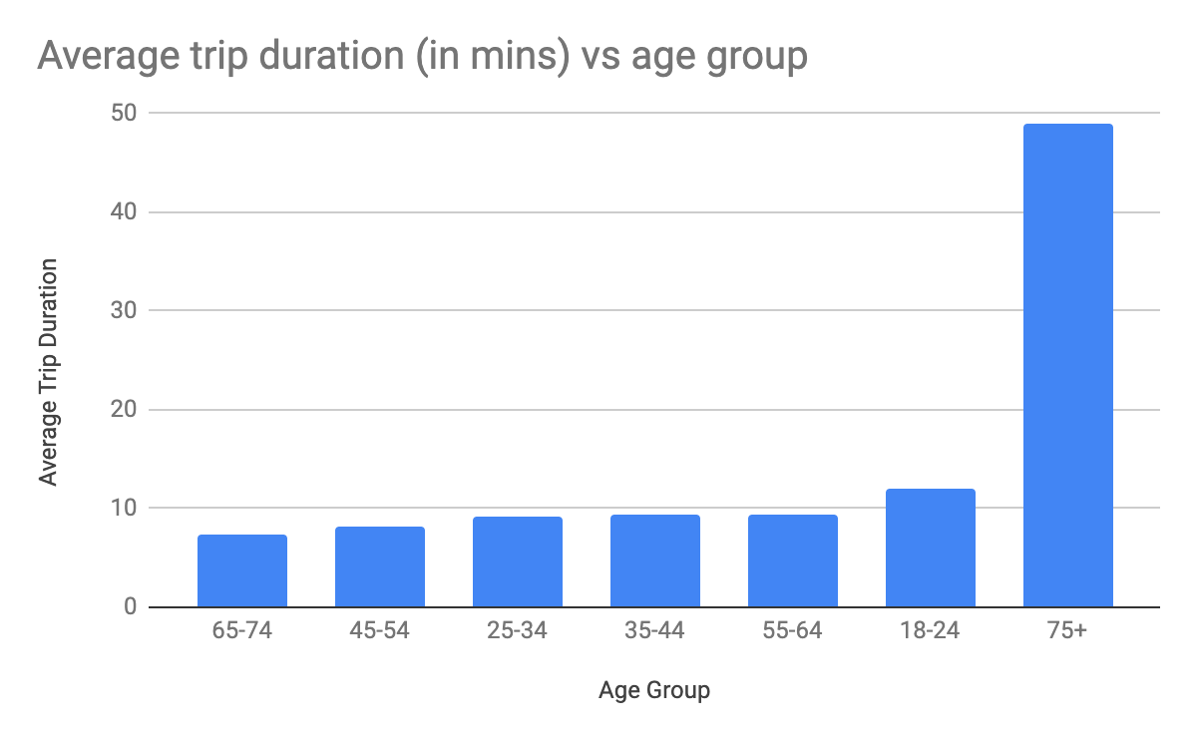
2. How does the average trip duration vary across different age groups?
75+ year olds take the longest trips
65-74 and 45-54 year olds take the shortest trips

Slide 7
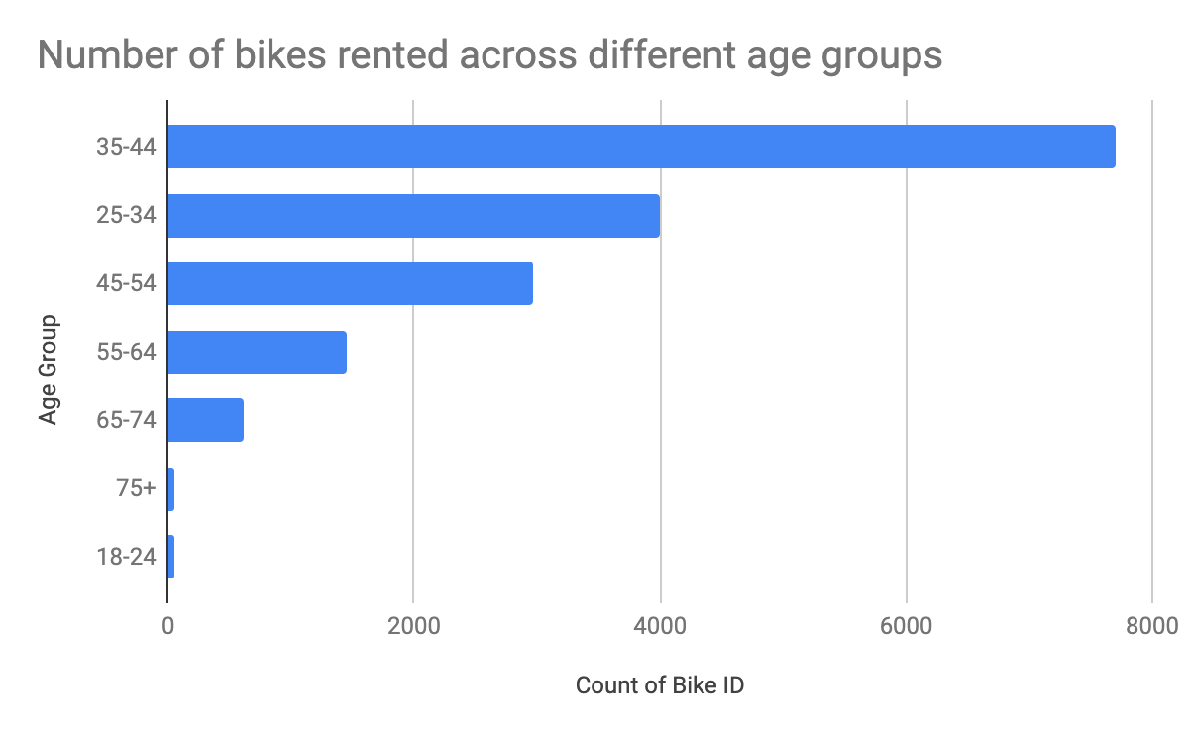
3. Which age group rents the most bikes?
35-44 year olds rent the most bikes
75+ and 18-24 rent the least bikes

Slide 8
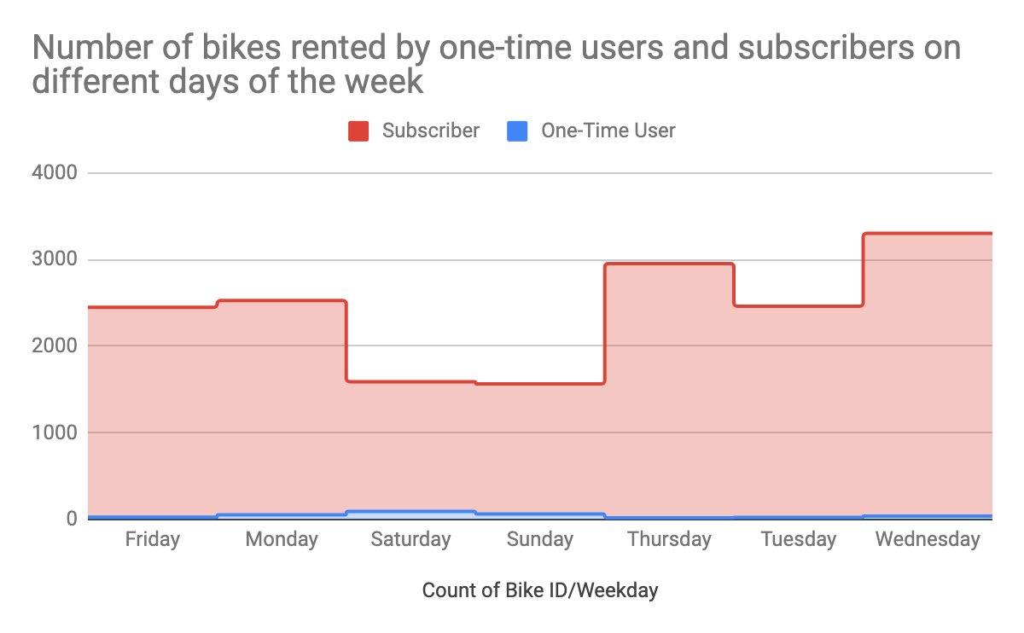
4. How does bike rental vary across the two user groups (one-time users vs long-term subscribers) on different days of the week?
Subscribers are more active during the week
One-time users are more active during the weekends
Majority of Citi bikes customer base are long term subscribers

Slide 9
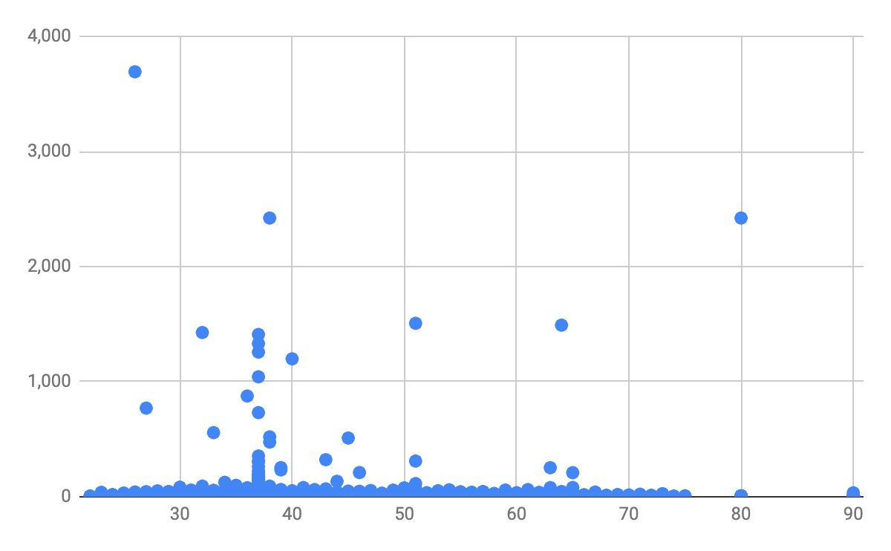
5. Do factors like weather and age impact the average bike trip duration?
No correlation between user age and trip duration

Slide 10
Summary

Slide 11
Summary of findings:
Top 5 pick-up locations for bikes:
Grove St Path, Exchange Place, Sip Ave, Hamilton Park, & Morris Canal
Customer base:
Long term subscribers are more active during the week
One time users are more active at the weekends
35-44 year olds rented the most bikes
Citi Bike customer behavior:
75+ year olds take the longest trips on average, but rent the least bikes
65-74 and 25-34 year olds take the shortest trips

Slide 12
Actions & Recommendations

Slide 13
Recommended actions:
Product recommendations:
Install more bikes at ...
Marketing recommendations:
The Citi Bike customer base is mostly long term subscribers aged between 35-44, who are most active during the weekdays. This tells us that they are probably people who live in New York and use Citi Bikes to commute. Marketing and advertising campaigns should therefore target this particular demographic.

Slide 14
Thank you!

